Slide 1
Haskell
Nick Leluan & Taylor Willittes

Slide 2
History of Haskell
At the Functional Programming Languages and Computer Architecture conference people wanted to form a committee to consolidate existing functional languages into a common one for future research. “Haskell was then developed by the 25 person committee in 1990.” (Tate)
Haskell was created to be a pure functional language where the research community could unite. The committee that created Haskell wanted to combine ideas from the best functional languages and define an open standard for functional languages.
Haskell is “designed for teaching, research, and proprietary businesses because of its fast application development.” (Wikimedia Foundation). Great start to learn functional programming.
Haskell is a pure functional programming language (hallmarks of functional languages: recursion, single-valued variables). Clean and direct code meaning a 6 line code in java can be reduced to 2 lines in Haskell. Strong static typing and lazy processing.

Slide 3
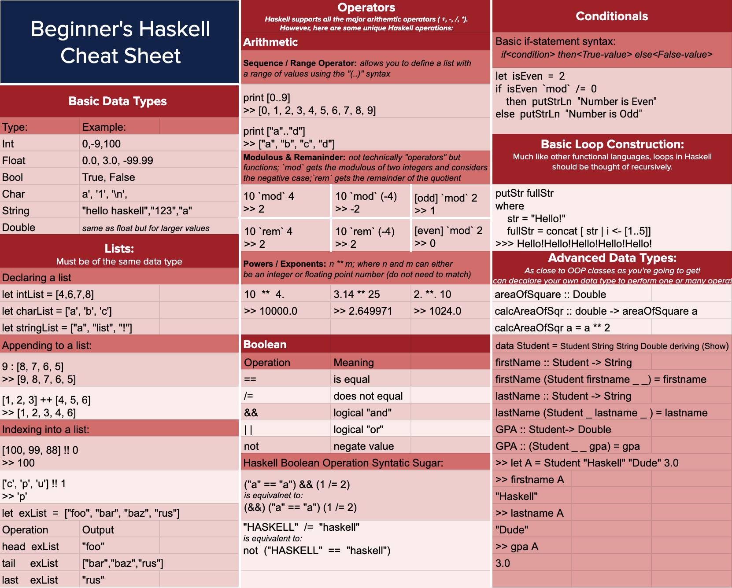
Cheat Sheet

Slide 4
Demo
https://www.youtube.com/watch?v=3YAPP2B7HAM

Slide 5
Higher-Order Functions
Functions that take in another function as an argument
Built in higher-order functions in Haskell
map/foldr/foldl
Video that explains and shows how to use them in Haskell: https://youtu.be/_GzGPFMn7Fs

Slide 6
Opinion of the Language - N’s Take
I enjoyed learning the language, it was interesting learning a different way of thinking about programming away from object oriented programming.
The language is very compact and fast to write out -- if you know what you are doing. I can see the advantages of embedding haskell scripts in portions of a larger project to perform quick and easy computations that are elegant to write.
A huge learning curve compared to object oriented programming. Compared to interpreted languages like Java and or C++, you must think of structures of any kind is immutable. Recursion is an absolute must. Like in ML, loops aren’t as easy as declaring “for” or “while”, so even simple string looping requires a recursive function.
I would recommend this language for other programmers. The reason why I pushed to learn this language was because I was told by a Senior Developer at my internship that he wished more programmers knew functionally programming languages, namely Haskell. Of course he could be an old man yelling at a cloud, but he seemed pretty serious when he said there is a shift happening away from OOP to Functional...but we will see. Haskell, like most functional programming languages, is difficult to transition to from other OOP languages, but after doing this assignment and forcing myself to do more recursion, I feel like I can program even better in languages like Java or Python.
We touched a little bit of list comprehension. But just the surface level. Some examples in text and online of well formulated list comprehension was quite impressive. I will probably continue to learn basics of functional programming and do a deeper dive into advanced list comprehension.

Slide 7
Opinion of the Language - T’s Take
I enjoyed using the language because it was fun to learn a functional programming language that wouldn’t be covered in the CS classes. It was fun to play around with the language as the structure was different than anything I have learned before.
The language is useful because it is fast and is more expressive than any languages I’ve used.
The only other languages I know are Python, Java, and C. Python is the most similar to haskell in the sense that they are both strongly typed languages, but Haskell is much faster than Python. I feel that Python, Java or C is easier to learn than Haskell since Haskell has such a steep learning curve.
I would recommend this language to other programmers because after you get over the learning curve, it is pretty fast and easy to use. I feel like it also shows you a new perspective on programming.
Other aspects I would be interested in is how Haskell is used for building websites and how you can compile Haskell to JavaScript.

Slide 8
References
Commenting. Commenting - HaskellWiki. (n.d.). Retrieved September 24, 2021, from https://wiki.haskell.org/Commenting.
Drop. Hoogle. (n.d.). Retrieved September 25, 2021, from https://hoogle.haskell.org/?hoogle=drop.
Haskell/Truth values. Wikibooks, open books for an open world. (n.d.). Retrieved September 24, 2021, from https://en.wikibooks.org/wiki/Haskell/Truth_values.
Operators in Haskell. CherCherTech. (n.d.). Retrieved September 24, 2021, from https://chercher.tech/haskell/operators.
Starting out. Starting Out - Learn You a Haskell for Great Good! (n.d.). Retrieved September 24, 2021, from http://learnyouahaskell.com/starting-out.
Tate, B. (2012). Seven languages in seven weeks a pragmatic guide to learning programming languages. The Pragmatic Bookshelf.
Wikimedia Foundation. (2021, September 16). Haskell (programming language). Wikipedia. Retrieved September 23, 2021, from https://en.wikipedia.org/wiki/Haskell_(programming_language)#:~:text=Designed%20for%20teaching%2C%20research%20and,Glasgow%20Haskell%20Compiler%20(GHC).&text=Haskell%20is%20used%20in%20academia%20and%20industry.

